Slide 1


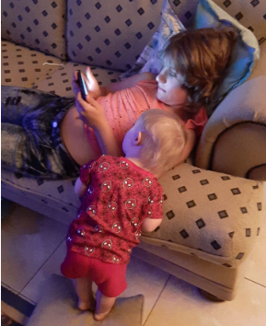




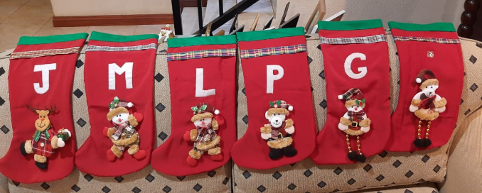
Merry Christmas – 2020

Slide 2

Merry Christmas 2020

Slide 3
_dataStorage
RFQHEAD
RFQREQITEMS
RFQRESITEMS
RFFQRESPHEAD
GUID
EMAIL
Ref_Text
RFQNo
Cut-off
Delivery Date
Request_Text
GUID
EMAIL
RFQGUID
ITEMNO
Material
Short_Text
Long_Text
Quantity
GUID
EMAIL
RFQGUID
ITEMNO
Price
Long_Text
Del_Horizon
GUID
EMAIL
RFQGUID
Long_Text
Acceptance
Response_Date
RFQ List
Model-Service
RFQHeader
Information
Vendor
Cut-off dates
Info-Documents
Request Texts
Item Texts
Update
Pricing (item-KEYS)
Response-Texts(item-TAGS)
Response-Documents
Control-Dates (item-DATA)
Index keys
Guid-Obj-Sub_Context
GUID-EMAIL-RFQGUID
RfqInfo
Docs
Response
RfqResp
Docs
Keys
Documents
Response Text
Documents
RFQItems and tenderItems
Rfq-Item
Item
Texts
Pricing

Slide 4
Data Structure of RFQ Solution
ZIO_RFQUOTE
export class BIDCONTROL{
RELEASE_DATE: string;
VIEWED_ON: string;
RESPONDED_ON: string;
EMAIL_LINK: string;
ADDEDBY: string;
ADDEDON: string;
VALIDITY: number;
ACCEPTANCE: string;}
ZRFC_OBJ Headerline(Tender)
ZRFC_OBJ Vendorline(Bid)
export class RfcObj {
MANDT: string;
GUID: string;
OBJ: string; SUBMI or REFNO
OBJ_TYPE: string; RFQUOTE
CONTEXT: string; Short Text Description
SUB_CONTEXT: string; Object type e.g. RFQ
CREATED: number;
DATA: string; Control Dates
DATA_TYPE: string; STATUS
MODIFIED: number;
DATA_MD5: string;
TAGS: string; Request Long text
KEYS: string; Tender ITEMS
}
export class RfcObj {
MANDT: string;
GUID: string;
OBJ: string; Email
OBJ_TYPE: string; Vendor No
CONTEXT: string; Unique Token
SUB_CONTEXT: string; REFNO
CREATED: number;
DATA: string; Control & Dates
DATA_TYPE: string; Short Text Description
MODIFIED: number;
DATA_MD5: string;
TAGS: string; Response Long Text
KEYS: string; Bid ItemsResponse
}
ZWEB_BID_ITEM
export interface BidItem {
itemno: string;
assumption?: string;
bidprice?: number;
leadtime?: string;
validity?: string;
biddate?: string;
}
ZWEB_TENDER_ITEM
ZRFQ_CONTROL
On WEB-Only
export class TENDERITEM {
ITEMNO: string;
MATERIAL: string;
MTEXT: string;
QUANTITY: number;
UOM: string;
MLONGTEXT: string;
DELIVERYDATE: number;
VALIDITY: string;}
export class CONTROL_DATES {
CREATED: string;
STARTDATE: string;
CUTOFFDATE: string;
CUTOFFTIME: string;
RELEASED: string;
CREATEDBY: string;
RELEASEDBY: string;
CONTACTMAIL: string;
CONTACTTEL: string;
CONTACTNAME: string;
DELIVERYDATE: string;
CLOSED: string;
CLOSEDBY: string;
VALIDITY?: string ;
}
export interface Tender
1 guid: HEADER-GUID;
2 email: BID-OBJ;
3 bidGuid: BID-CONTEXT;
4 rfqNo?: BID-SUB_CONTEXT;
5 refText?: BID-DATA_TYPE;
6 reqText?: HEADER_TEXT ;
7 cutoff?: Header-DATA-> Control Dates ;
8 cutofftime?: Header-DATA-> Control Dates;
9 validity?: BID-DATA->Control;
10 contactEmail?: Header-DATA-> Control Dates;
11 contactTel?: Header-DATA-> Control Dates;
12 contactName?: Header-DATA-> Control Dates ;
13 infoItems?: Header-KEYS
14 bid?: BID-KEYS;
}
Merge?

Slide 5
Data Structure of RFQ Solution
ZIO_RFQUOTE
export class BIDCONTROL{
RELEASE_DATE: string;
VIEWED_ON: string;
RESPONDED_ON: string;
EMAIL_LINK: string;
ADDEDBY: string;
ADDEDON: string;
VALIDITY: number;
ACCEPTANCE: string;}
ZRFC_OBJ Headerline(Tender)
ZRFC_OBJ Vendorline(Bid)
export class RfcObj {
MANDT: string;
GUID: string;
OBJ: string; SUBMI or REFNO
OBJ_TYPE: string; RFQUOTE
CONTEXT: string; Short Text Description
SUB_CONTEXT: string; Object type e.g. RFQ
CREATED: number;
DATA: string; Control Dates
DATA_TYPE: string; STATUS
MODIFIED: number;
DATA_MD5: string;
TAGS: string; Request Long text
KEYS: string; Tender ITEMS
}
export class RfcObj {
MANDT: string;
GUID: string;
OBJ: string; Email
OBJ_TYPE: string; Vendor No
CONTEXT: string; Unique Token
SUB_CONTEXT: string; REFNO
CREATED: number;
DATA: string; Control & Dates
DATA_TYPE: string; Short Text Desc
MODIFIED: number;
DATA_MD5: string;
TAGS: string; Response Long Text
KEYS: string; Bid ItemsResponse
}
ZWEB_BID_ITEM
export interface BidItem {
itemno: string;
assumption?: string;
bidprice?: number;
leadtime?: string;
validity?: string;
biddate?: string;
}
ZWEB_TENDER_ITEM
ZRFQ_CONTROL
On WEB-Only
export class TENDERITEM {
ITEMNO: string;
MATERIAL: string;
MTEXT: string;
QUANTITY: number;
UOM: string;
MLONGTEXT: string;
DELIVERYDATE: number;
VALIDITY: string;}
export class CONTROL_DATES {
CREATED: string;
STARTDATE: string;
CUTOFFDATE: string;
CUTOFFTIME: string;
RELEASED: string;
CREATEDBY: string;
RELEASEDBY: string;
CONTACTMAIL: string;
CONTACTTEL: string;
CONTACTNAME: string;
DELIVERYDATE: string;
CLOSED: string;
CLOSEDBY: string;
VALIDITY?: string ;
}
export interface Tender
1 guid: HEADER-GUID;
2 email: BID-OBJ;
3 bidGuid: BID-CONTEXT;
4 rfqNo?: BID-SUB_CONTEXT;
5 refText?: BID-DATA_TYPE;
6 reqText?: HEADER_TEXT ;
7 cutoff?: Header-DATA-> Control Dates ;
8 cutofftime?: Header-DATA-> Control Dates;
9 validity?: BID-DATA->Control;
10 contactEmail?: Header-DATA-> Control Dates;
11 contactTel?: Header-DATA-> Control Dates;
12 contactName?: Header-DATA-> Control Dates ;
13 infoItems?: Header-KEYS
14 bid?: BID-KEYS;
}
Merge?

Slide 6
tenderHeader
tenderLine
tenderItems
controldates
Esourcing – list of open Tenders user is linked to
Select 1
Rfq
Display loading gif until loaded – go to header
Get Tender and Bid
And Docs linked
Upload Overall Assumption, Validity and Documents
Update item
Build Tender Object
Rfq-header
Show Information
Download Documents
Bid >>
Rfq-items – list of Tender items
Accept Bid
Overall Validity
Overall Assumption
Upload Documents
Rfq-item-detail – Fill in
Price,
Validity and
Assumptions
Select 1

Slide 7



Reference Object is any one of these
Note: RFQ
can reference
only one object
Tender Reference RFQ
First RFQ as Items
Tender Requirements
Control Record
End Date,
Validity,
Status
Documents
Status List:
New
Release
Cancelled
Closed
Validated
HEADER
I
TEM
Tender Reference Notification
Manual Setup
Tender Items
Standard Documents
Tender Reference Purchase Requisition
Purchase Requisition Items
Note: Once RFQ is Released, any changes at header level will trigger an email to ALL bidders
Tender Reference Work Order
Components as Items
Tender Reference Project
Manual Setup
Note: Items are copied when tender is created
If changes are required, a new tender is required
B
ID
I
TEM
Status List:
New
Quoting
Rejected
Commit
Bid Items
Vendor Record
Add New Vendor to Bid
Vendor Partner
Bid
Vendor Contact in ZPARTNER
Email and SMS Services
Control Dates Record
(Set Status)
Response Documents
Note: An entry must exist in ZPARTNER (or be created) for Vendor Partner

Slide 8
RFQHeader
Merge to Tender
Extract ResponseText
Edit ResponseText
RFQVendor
Merge to TenderItem[]
Keys & Keys
Change to Bid Response: text,
Items: BidItem[]
Extract to BidItem
Edit Bid Item
RFQHEAD
Update Bid
Update TenderItem[]
Update SAP
Update Control
GUID
EMAIL
Ref_Text
RFQNo
Cut-off
Delivery Date
Request_Text
BidPriceResponse
BidResponse
guid: string;
email: string;
bidGuid: string;
itemindex: string;
assumption: string;
bidprice: number;
horizon: string;
quality: string;
lastdate: string;
guid: string;
email: string;
bidGuid: string;
longtext: string;
quality: string;
lastdate: string;
RFQREQITEMS
GUID
EMAIL
RFQGUID
ITEMNO
Material
Short_Text
Long_Text
Quantity

Slide 9
Check if more than 1 RFQ for EMAIL
>1
No –> go to RFQ
Information, Documents , Printed Version
Comment
List of RFQ’s for Selection
BidPriceResponse
BidResponse
guid: string;
email: string;
bidGuid: string;
itemindex: string;
assumption: string;
bidprice: number;
validity: string;
horizon: string;
quality: string;
lastdate: string;
guid: string;
email: string;
bidGuid: string;
longtext: string;
quality: string;
lastdate: string;
Request Material Text
Price
Price Validity
Availability
QA
Assumptions and Conditions

Slide 10
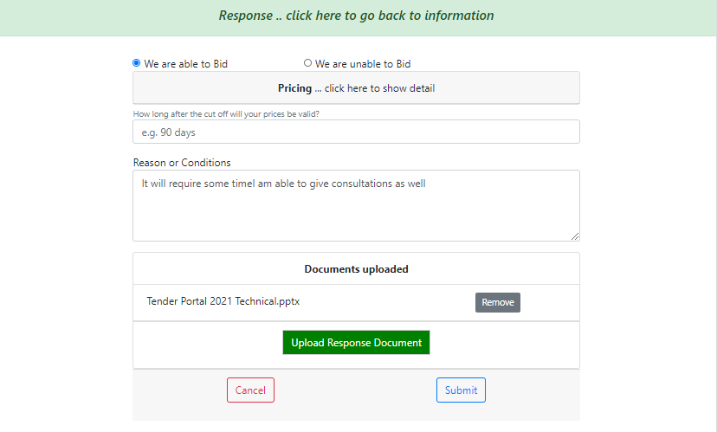
Bid.acceptance
Bid.items[]
Bid.validity
Bid.response

Slide 11
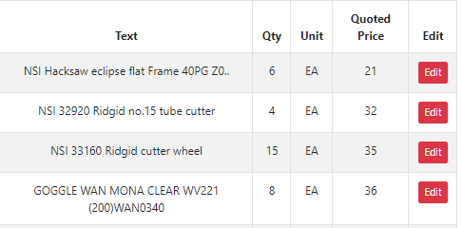
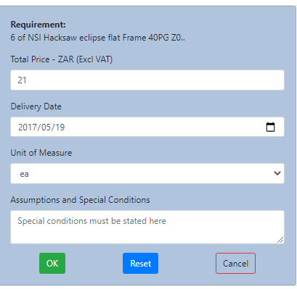
tenderItem.quantity
tenderItem.itemindex
Item 0010
..more
tenderItem.matText
tenderItem’longText
BidItem.bidprice
Lead time needed
Ex-Stock
BidItem.leadtime
Price Validity Period
90 Days
BidItem.validity
BidItemResponse
BidResponse
guid: string;
email: string;
bidGuid: string;
itemindex: string;
assumption: string;
bidprice: number;
validity: string;
leadtime: string;
lastdate: string;
guid: string;
email: string;
bidGuid: string;
longtext: string;
quality: string;
acceptance: string
lastdate: string;
BidItem.assumption

Slide 12
dd
dd
dd
dd
Angular
DME_API_V1
DME_API_V1
Mikethomson.biz
Mysql
Index.php
YII2
laravel

Slide 13
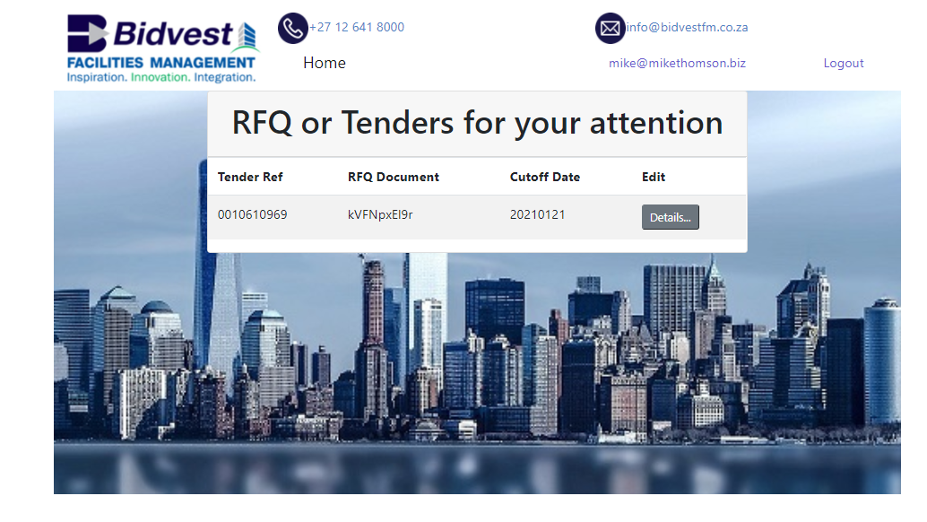
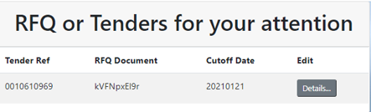
Welcome to our Tender Page
With almost 2 decades of experience within the facilities management sector, we are renowned for having the most competent technical skills and experience within this sector, covering all aspects of facilities management services generally, mechanical and electrical maintenance and engineering, environmental health & safety, energy and project management.
Your company has been selected to be eligible to quote us for work and services.

